Slide 1

Toucan User Evaluation
(CAB210 Assignment 3)
Rory Blair, n10773398, n10773398@qut.edu.au

Slide 2
Agenda
INTRODUCTION
METHODS
USABILITY FINDINGS
USER EXPERIENCE FINDINGS
REDESIGN SUGGESTIONS
SUMMARY

Slide 3

Introduction
Aim:
The aim of this evaluation is to assess the user experience and usability of the chosen app, Toucan, and create suggestions for redesigning the app.
Target Users:
The targets audience for this app is for either individuals and/or teams.
Toucan:
A mood tracking application where individuals and teams can comprehend how themselves or their team are feeling at any time; without risking an individual's privacy.
UX Framework:
The ‘Four Pleasures’ is a framework that is used to help user experience designers to make visually and functionally appeasing designs by satisfying the four human pleasure (Physical, Social Psycho-logical and ideological). This framework was created by Dr Patrick Jordan.

Slide 4

Participant
Age: Late 50’s
Gender: Female
Studies: Accounting at Griffith University
Experience with Mood: None
Experience with Tracking: None except step count

Slide 5
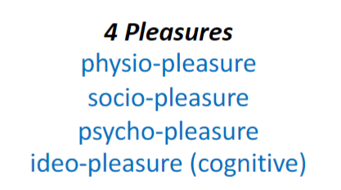
Methods
Using the 4 pleasures framework The following Methods are created to help create data that will help redesign the App (Note: Both Interview were recorded)
An Interview: Undertaken before the participant uses the app.
  A Usability test: To test the current design of the app
    Tasks to be undertaken (E.G. check-in)
  SUS Table: Giving an overall score
  Other questions and comments
    3 good things, 3 bad things and any other comments about the app
A 3-Day Trial: Undertaken for 3 day between Interview 1 and Interview 2
  Is told to check-in at least once or twice a day, whenever they feel like it. (Note: they are not limited to 2 check-ins a day)
  It is up to them if they would like to undertake a moment or read an article.
A Post-trial Interview: Undertaken to see if data collected from the pre-trial interview matches with the post-trial interview.
  Questions relating to the overall experience using the app
  Questions asking what parts of the check-in process would they change.
  Questions about frequent use of the app
  Questions about easy of use and navigation.

Slide 6
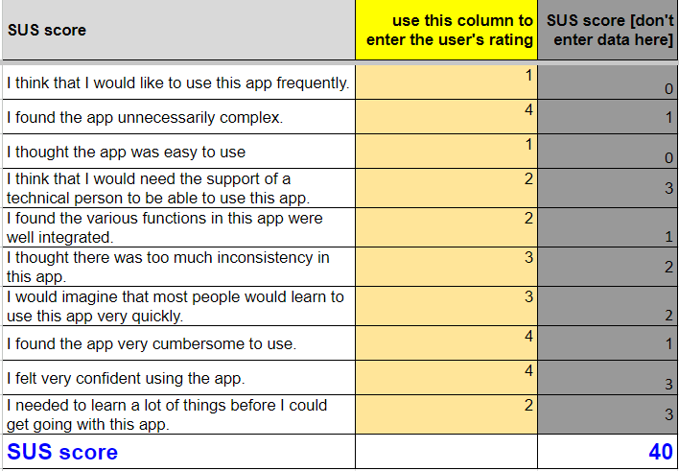
Usability Findings
Work Well | Didn’t work well
Check-in process is easy | Too much is contained within the drop-down menu.
 | Layout of most pages.
 | Mood Selection within check-in process.
 | Too much text on some pages(Moments and articles)
 | Hard to find more serious help.
 | Moments don’t care. (Ask if you are better but don’t allow a response to the question given)
50 and below is considered a failure, therefore this application is considered not user friendly based on the participants first trial of the app

Slide 7
User Experience Findings:
Highlight 1: Task 1 of Usability Test
(All quotes are from transcript)
Problems Identified within highlight:
  Layout
    (“Half the words are missing”)
  Mood Selection
    (“And there's not enough, there's happy, sad, anxious, angry, you could pick either of those and put between one to ten, five, just to be normal. So if I pick happy, but I'm not happy ecstatic, I'm just average, then I go in the middle. There's not enough moods”)
Suggestions to fix problems:
  Layout:
    Fix so that words are clearly visible and not cut out
  Mood Selection
    Allow a new system to be implemented to make these options easier.

Slide 8
User Experience Findings:
Highlight 2: Task 3 & 4 of Usability Test
(All quotes are from transcript)
Problems Identified within highlight:
  Layout
    (“The word moments in the heading isn't even on your screen. Have you seen how it's only moments, whoop, it's not all there, the heading, moments good. ”)
    (“I found it. I don't think it's very well labelled.”)
  To much text
    (“It doesn't say, take a moment and try to sort your scientifically back to normal. Well being activity, could they not have shortened that?”)
    (“Articles are down there, but again, articles for scientifically backed information to help you understand emotions and improve well being. Why does that need to be there? ”)
Suggestions to fix problems:
  Layout:
    Fix so that titles are not cut out
  To Much Text
    Shorten existing sentence to a concise sentence that still gets the message across

Slide 9
User Experience Findings:
Highlight 3: Task 6 of Usability Test
(All quotes are from transcript)
Problems Identified within highlight:
  To much content within dropdown menu
    (“Why wouldn't you have it somewhere more easily accessible? ”)
Suggestions to fix problems:
  To much content within dropdown menu
    Either delete the dropdown menu option or have less within the dropdown menu.

Slide 10
User Experience Findings:
Highlight 4: Comments after SUS Test
(All quotes are from transcript)
Problems Identified within highlight:
  Layout
    (“Um, I would do a better layout. ”)
    (“Not chopping off half the words on the first page of your mood. Add more moods. “)
  Mood Selection
    (“More neutral moods. ”)
  More Colour
    (“If you're engineering for people to be happy, this is to move towards people to be happy, it needs to be less bland.”)
  Less text
    (“Reduce the number of words on each page. There's a lot of words. ”)
  Navigation
    (“Needs to be more easily navigated.”)
Suggestions to fix problems:
  A complete re-design of the app taking the highlighted problems into consideration.

Slide 11
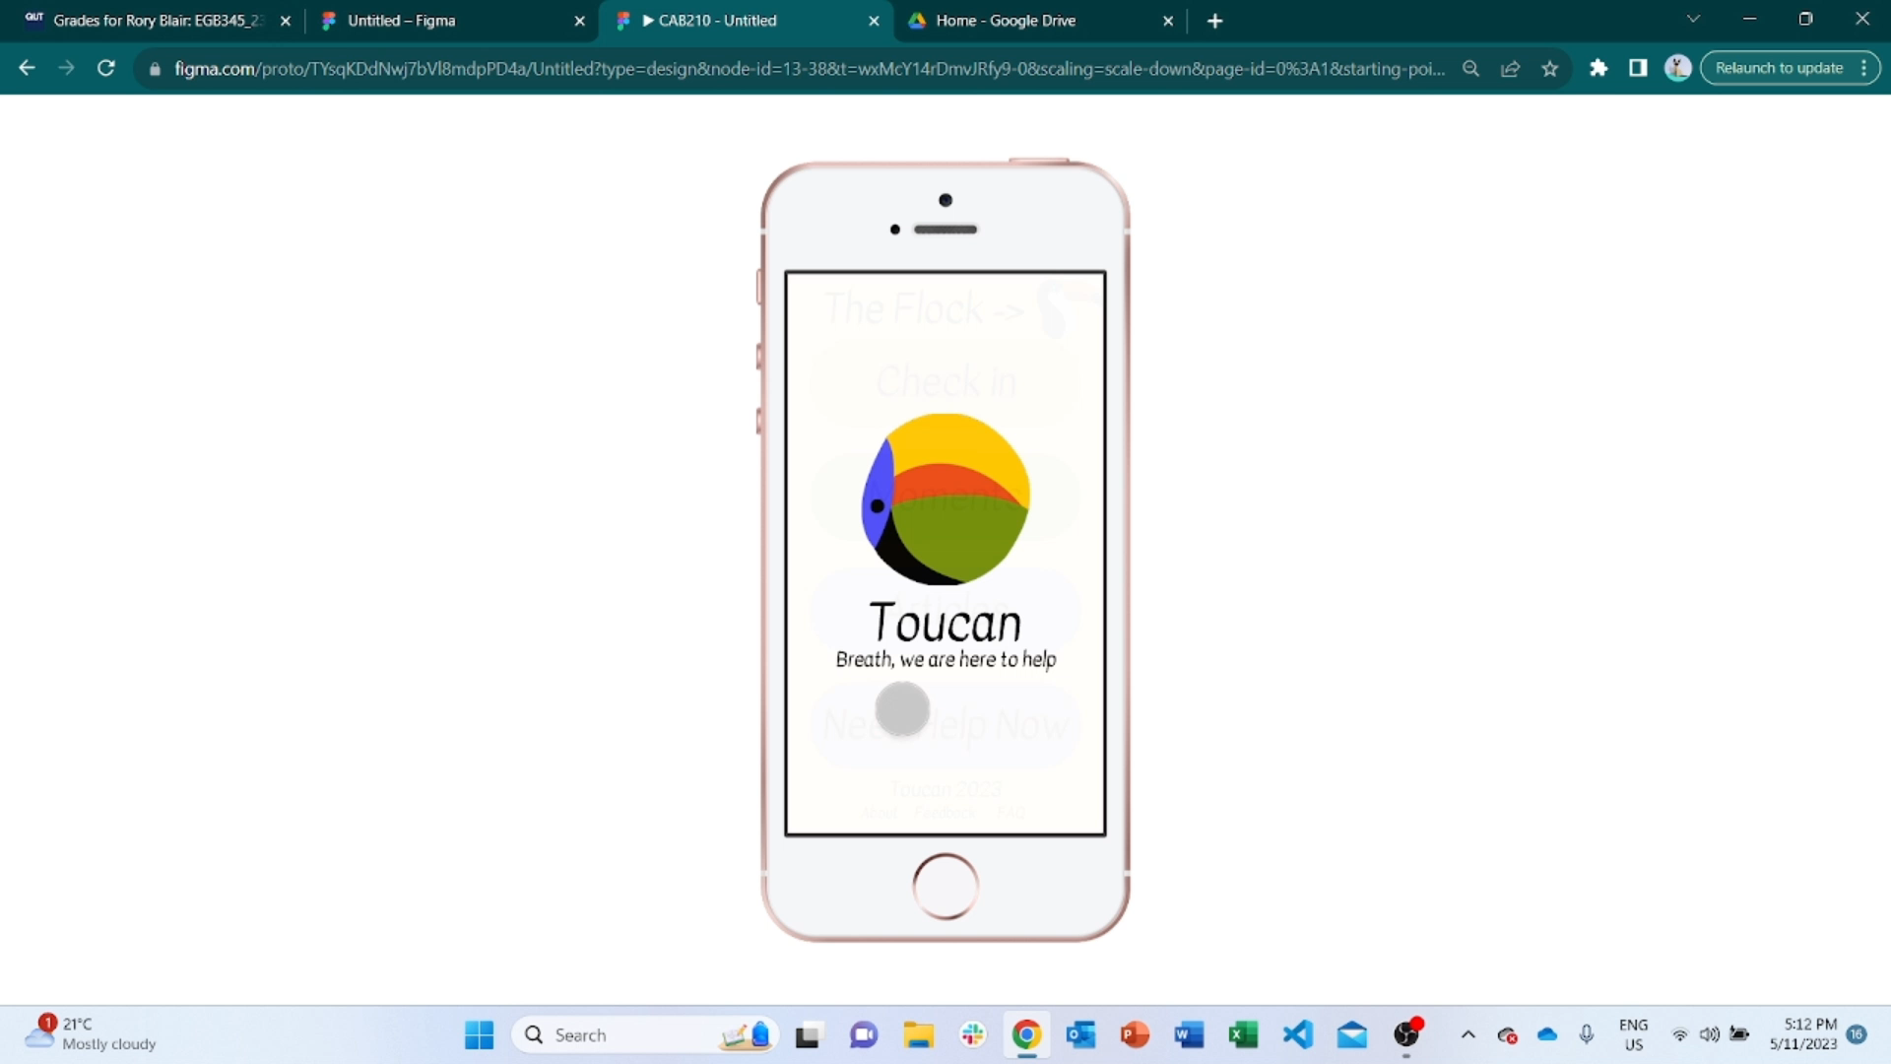
De-Design Suggestions
Using the data collected from the methods, multiple themes have appeared, some good, some bad, and are taken into consideration when re-designing this app
Layout
  The layout has been changed so nothing is cut off or arranged difficulty
Mood Selection
  Moods are grouped under positive, neutral or negative. Within the groups there are 3 main moods that corollate to that group.
More Colour
  There are more colours and boxes in black and white are now considered for emergency situations. Certain colours used for particular buttons/words (E.G. Sad = Navy Blue)
Navigation
  Now easier to navigate.
Too much in dropdown bar
  Gotten rid of dropdown bar and put it all on the home page, and other pages.
Too Much Text
  Once big blobs of text have either been removed or simplified.
Use link below to try it out for yourself:
https://www.figma.com/proto/TYsqKDdNwj7bVl8mdpPD4a/Untitled?type=design&node-id=13-38&t=udd79XY8KLyKUC7f-1&scaling=scale-down&page-id=0%3A1&starting-point-node-id=3%3A35&mode=design

Slide 12

Summary
Created methods of data collection based on the four pleasures framework.
Present the Usability findings that were identified
Present the User Experience findings that include the themes/problems identified throughout the evaluation/
Redesigned the application with the highlighted flaws taken into consideration.

Slide 13
Thank You for Listening
Rory Blair
n10773398
n10773398@qut.edu.au

